Slide 1
IT 303 Software Engineering
Mini Project
Intelligent Traffic Control Model Checking And Simulation Using UPPAAL
Team Members
Rakshit Kulkarni 191IT245
Mohit Awachar 191IT231
Anshul Patel 191IT208
Kiran Kumar J M 191IT126

Slide 2
Introduction :
Model Checking or property checking is method for checking whether a finite-state model of a system meets a given specification.
Here we are considering Traffic Light as our system for model checking.
Uppaal is an integrated tool for modeling,simulation and verification of real-time systems.
Typical applications are systems where timing is important such as real-time controllers and communication protocols.
We use this tool for model checking in our project.

Slide 3
Literature Review :
Ericksen et. al. used model based Stochastic Timed-Game Automata to control the traffic signals in one intersection of the road network. To this end, they used a newly developed tool from the Uppaal family of software tools called UPPAAL STRATEGO. The main aim of the paper was to find an optimal strategy to reduce waiting time.
In a paper published in 2019 by Thamilselvam Kalyanasundaram and SubrahmanyamRao M , the work of Ericksen was extended to multiple traffic light system. Again the goal here was to reduce waiting time.

Slide 4
Research Gaps :
There are no work for the model checking of traffic light system.
No paper was found in which was verifying the safety and reachability properties of the traffic light system.

Slide 5
Problem Statement :
Intelligent Traffic Light system Model Checking And Simulation Using UPPAAL

Slide 6
Objectives :
Express the Traffic light System as a model in the UPPAAL tool.
Perform model checking and simulation for the traffic light system in UPPAAL.
Verify the safety , reachability and deadlock condition for the Traffic Light System.

Slide 7
Proposed Contributions:
Model checking for the traffic lights system
Verification of safety, reachability properties and deadlock conditions for the TLS.

Slide 8
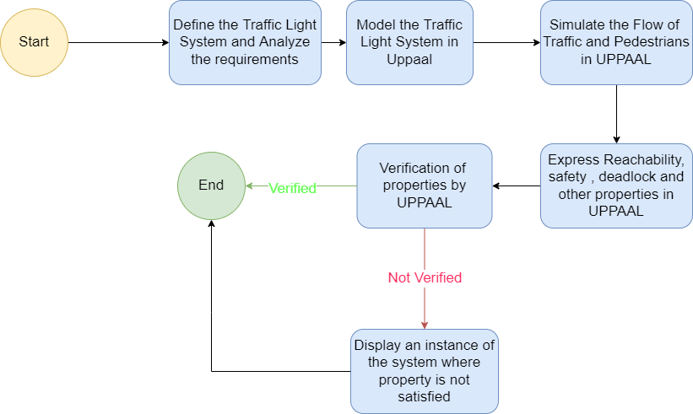
Methodology:
Proposed Work Flow

Slide 9
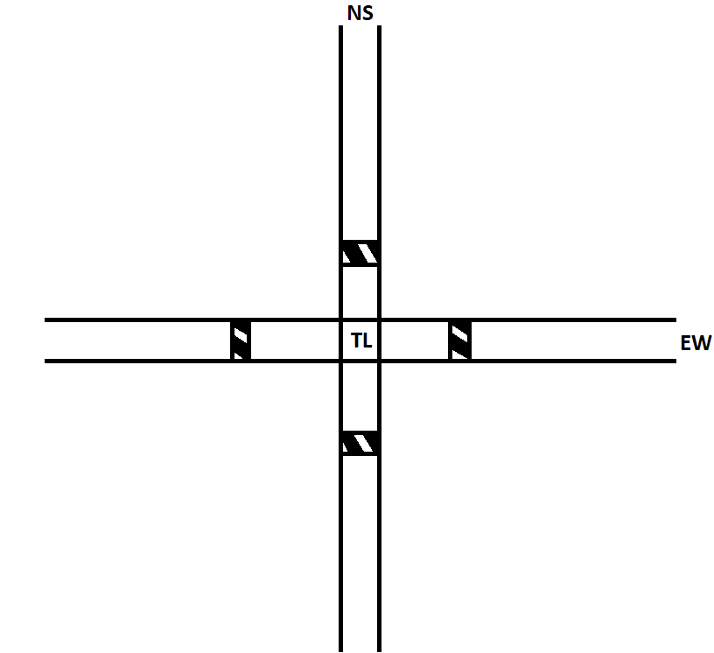
The Traffic Light System
When a lane is red the vehicle can’t cross. When the lane is green, the vehicle has a choice to cross or wait.
Once a lane(NS or EW) is made green, the lane remains green as long as some vehicle is waiting in the lane
Once both the lanes are red the pedestrians can cross the road. The lanes will remain red until all the pedestrians cross the lane.
The lane have a fixed timer of 5 seconds for the yellow signal.
The traffic lights go in order green-yellow-red-yellow-green.

Slide 10
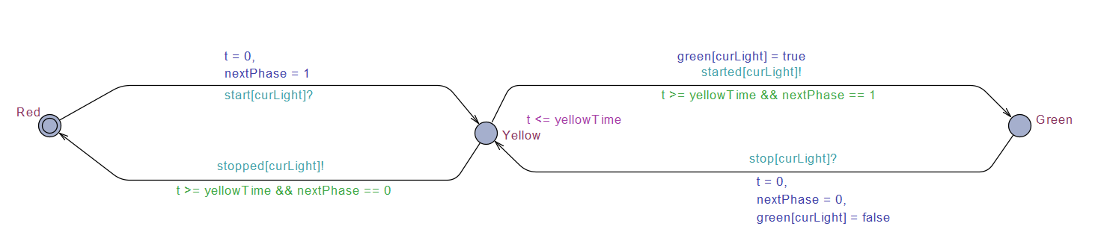
The Templates
Traffic Light : NS and EW

Slide 11
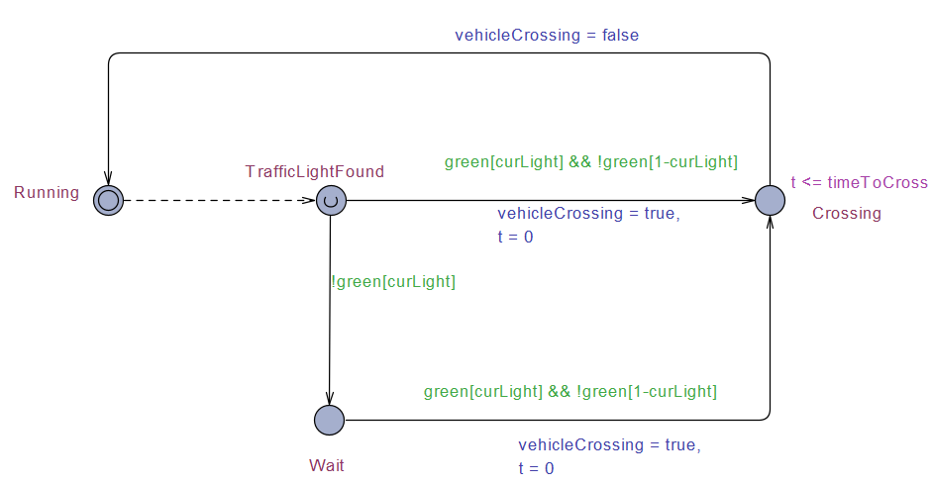
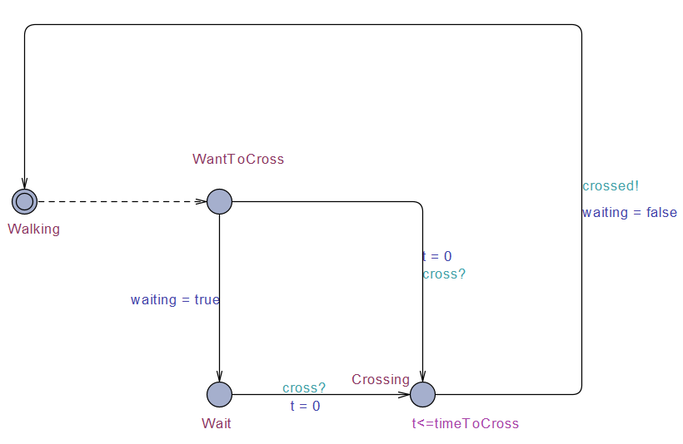
Vehicle : vehicle1 and vehicle2
Pedestrian

Slide 12
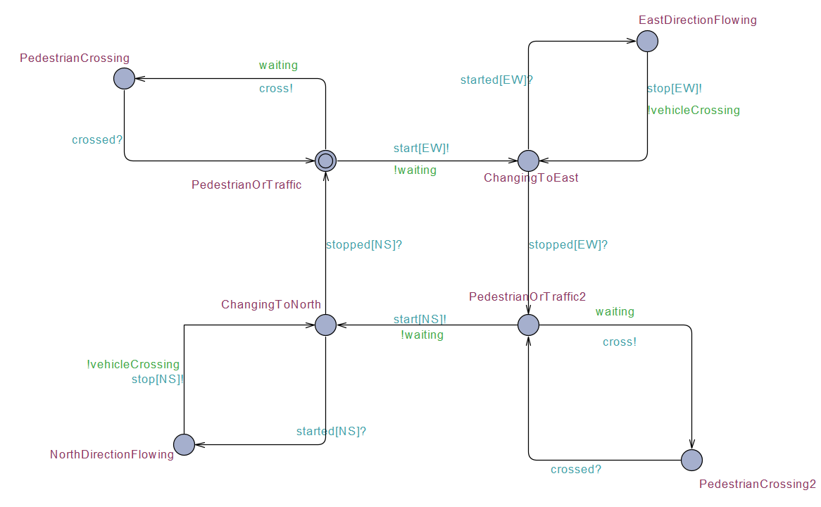
Controller

Slide 13
Properties to Verify:
Reachability Properties
All states are reachable for all the systems
Traffic Light
Pedestrian
Traffic Light Controller
Vehicle
Safety Properties
Both traffic lights can’t be green at the same time.
Pedestrians can’t cross when the corresponding traffic light is green.
Both lights can’t be yellow at the same time
Vehicles in perpendicular lanes can’t pass together.
When vehicle is crossing the traffic light should not change state to red.
Other properties
When vehicle is waiting, it will cross eventually
When pedestrian is waiting, he/will cross eventually
When one lane is active after some time other lane will be active
No deadlock

Slide 14
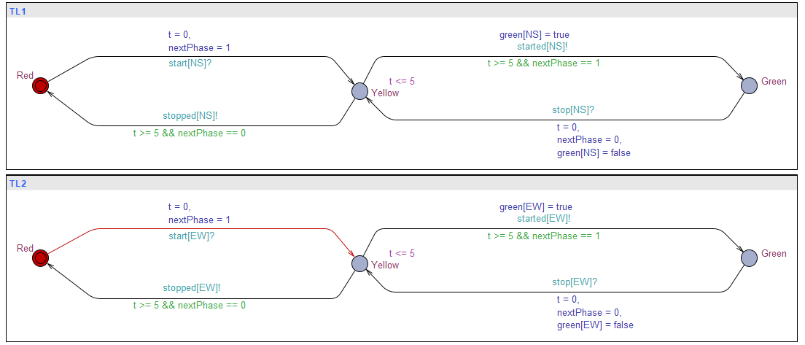
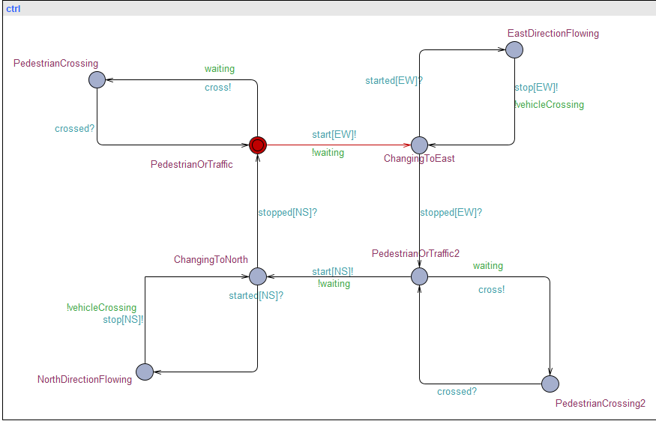
Results:
We have following subsystems in SIMULATOR
Traffic Light
Controller

Slide 15
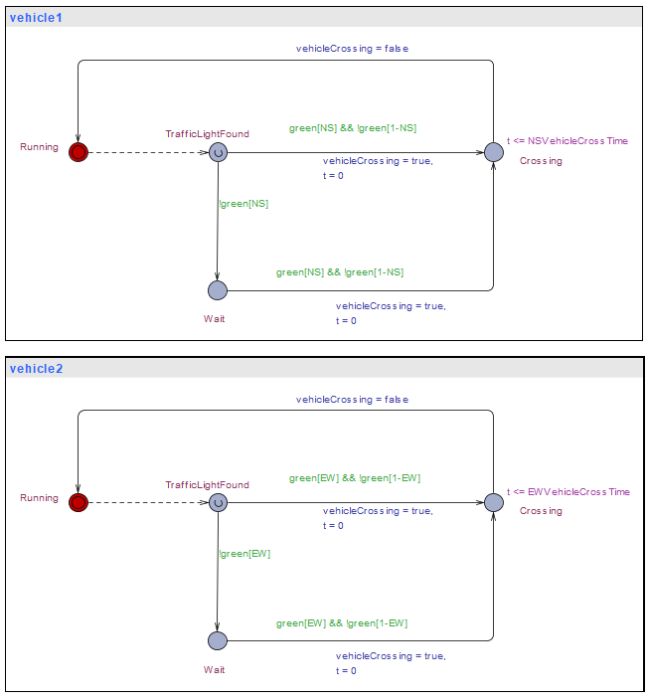
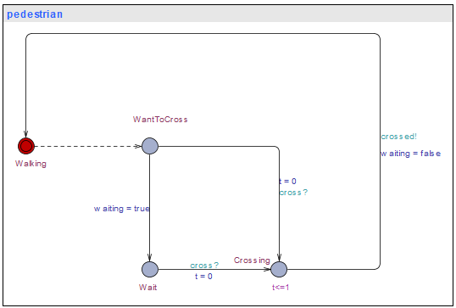
Pedestrians
Vehicles

Slide 16
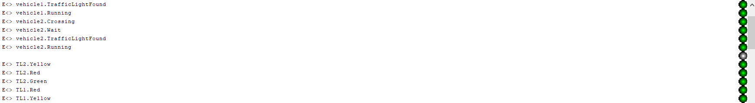
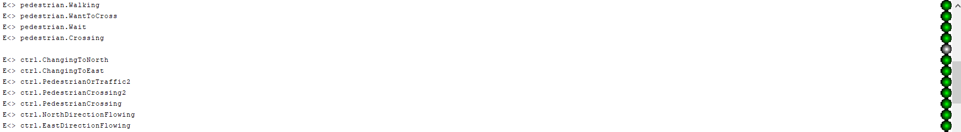
Verification of Queries
Reachability Properties

Slide 17
Verification of Queries
Safety Properties
Deadlock Condition

Slide 18
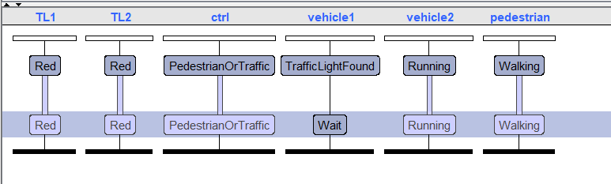
Verification of Queries
Other Properties
Failed Property

Slide 19
Conclusion :
Future Work:
All the safety and reachability properties of the Traffic Light system are verified.
The simulation and model checking can both be done in UPPAAL
Extend the work for more complex traffic junction with multiple lanes intersecting at a junctions.

Slide 20
THANK YOU

